Slide 1
You Can Set Up Early!
You need to install Python (3.10)
Make sure you tick the ‘add to PATH’ box during setup!
Then, you need to install Visual Studio Code
Once installed, get the Python Extension Pack
Then, you need to open the Week 1 Notebook there
This has everything you need for today.
go.uwcs.uk/python

Slide 2
Hi
(there’s a lot of you)
Notes:
First of all, hello! There’s quite a lot of you. It’s pretty scary.
Hopefully you didn’t have too much trouble finding the place. On the one hand, we’re really happy that so many of you turned up – on the other hand, we really need to move to a bigger lecture theatre for future talks.
Enjoy the welcome talk from Stuart Croft yesterday? Good, because that’s the first and last time you’ll be seeing him. Well, unless someone else decides to invade a country.
A quick show of hands – how many people are taking a CS degree? How many of you have never programmed before?
Alright – hopefully everything’s set up okay, and we’ll go ahead and start the welcome talk

Slide 3
What We’re Doing Today
10m - Intro
40m - Talk
70m - Workshop
Notes:
The rough structure of things is as follows.
(Mention pizza)

Slide 4
Introduction

Slide 5




?
Notes:
But let’s back up a little. What exactly *is* XSoc? Well, it’s basically just a joint name that we’re going to be using to refer to the three societies collaborating on this course.
That’s the University of Warwick Computing Society, or UWCS for short, Warwick Artificial Intelligence - or AI, and Warwick Coding Society. There are 6 of us here in total, 2 from each society:

Slide 6








Alia (CSE, 3)
Alistair (DM, 3)
Piotr (CS, 3)
Edmund (CS, 3)
Laura (DM, 4)
Alfie (CS, 2)
Notes:
Smile and wave boys, just smile and wave

Slide 7
Courses Industry Talks Student Talks Challenges Workshops CTFs Tech Services Gaming uwcs.co.uk Socials
Notes:
UWCS is a free-to-join society open to anyone with an interesting in Computing (not just CS students). We host weekly pub meals, game nights and academic sessions – aiming to support you throughout your degree. We also offer a wide range of tech services (e.g., website hosting and game servers) for free.

Slide 8


Slide 9
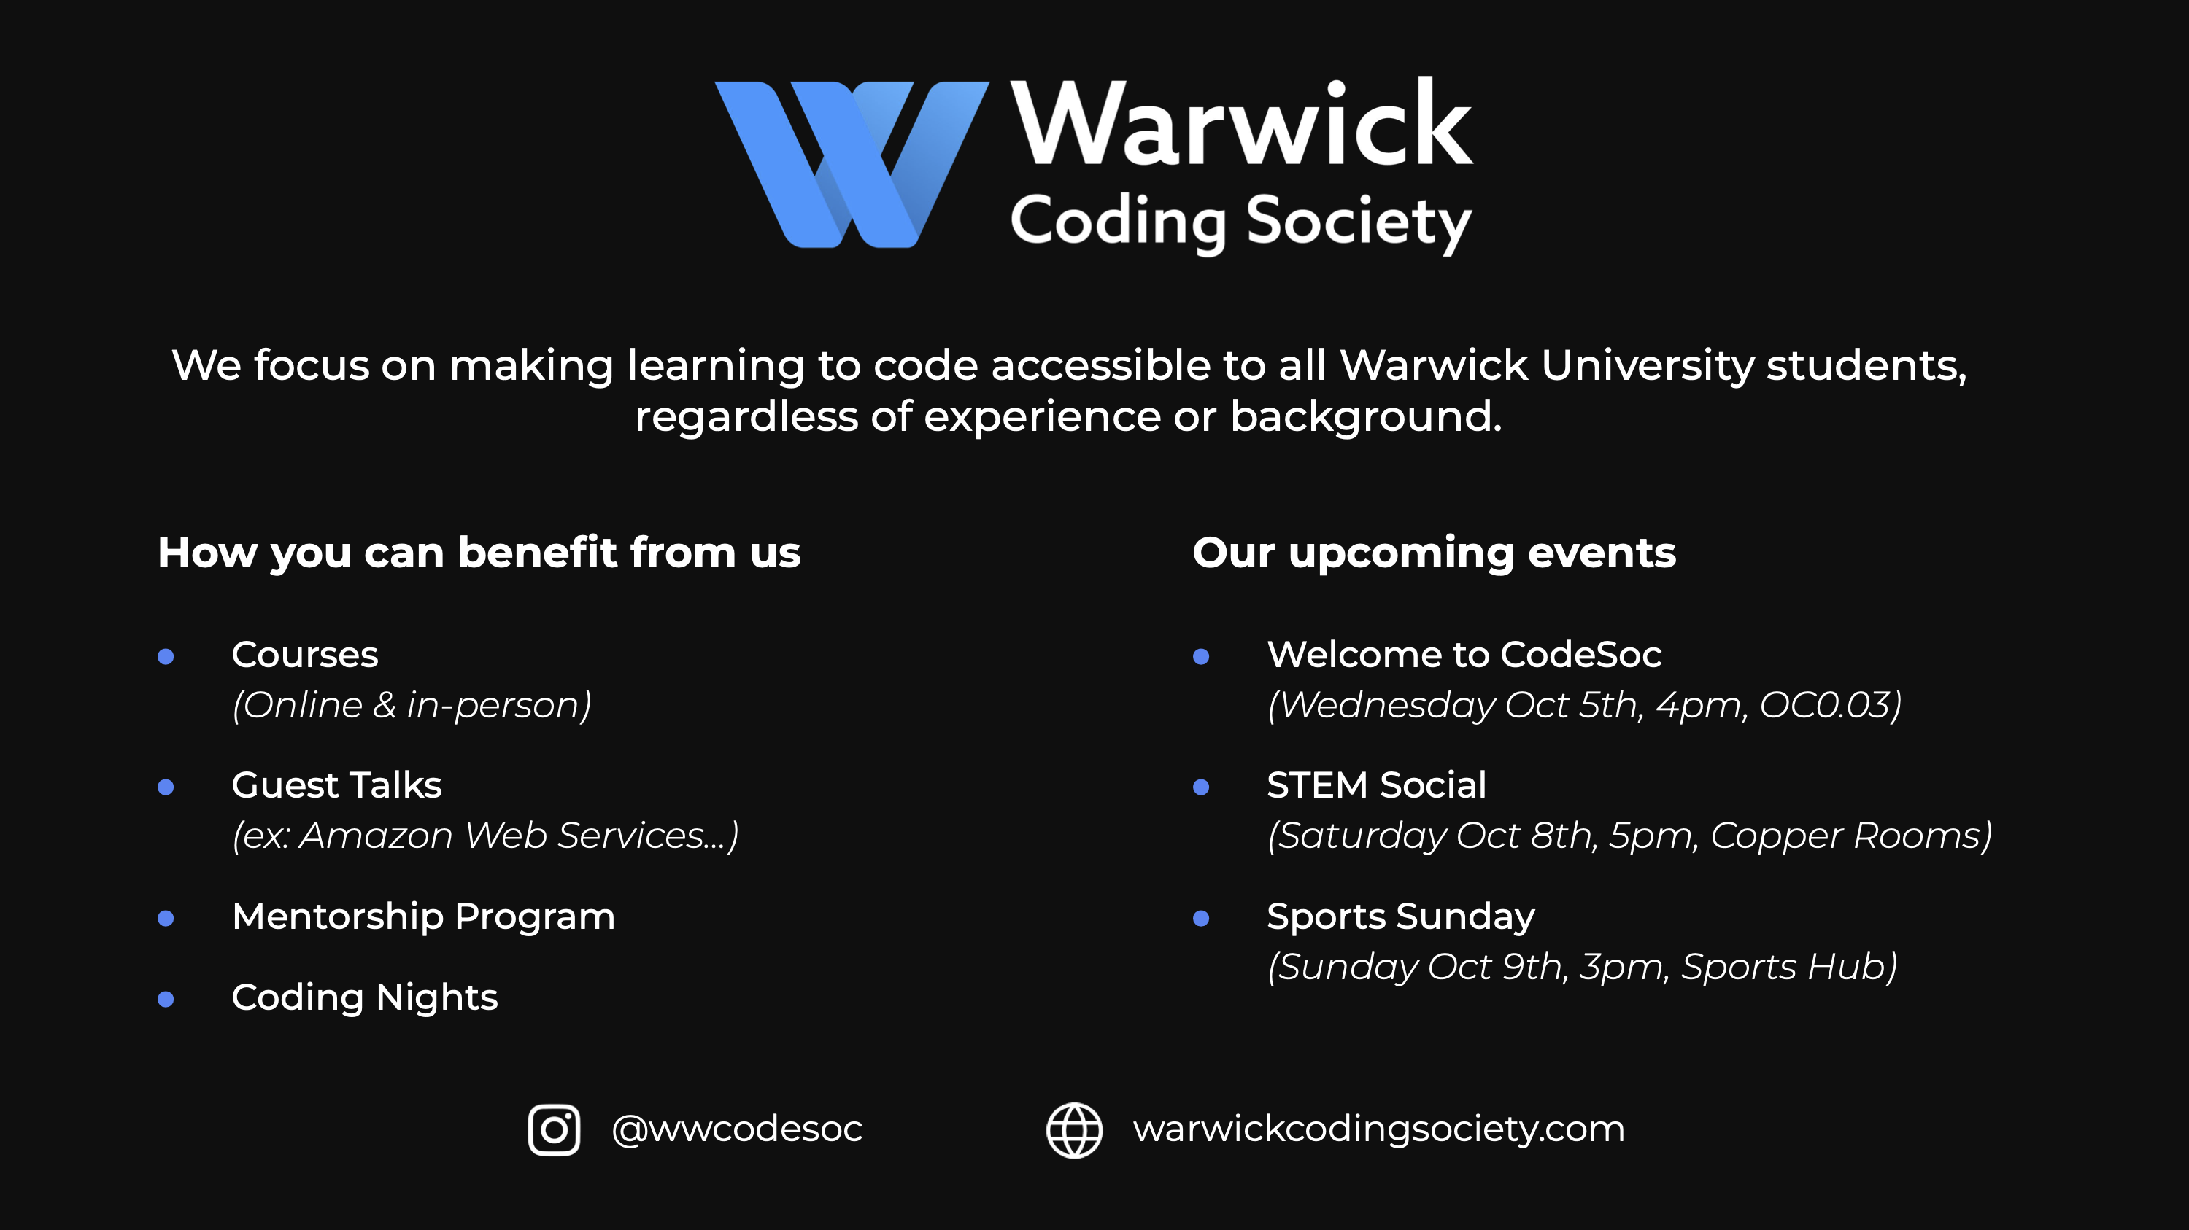

Slide 10
Course Overview
1: Variables, Datatypes & Exceptions
Presented by: Computing
2: Flow Control & Functions
Presented by: Coding
3: Lists & Loops
Presented by: Coding

Slide 11
Course Overview
4: File Handling & The Command Line
Presented by: AI
5: Objects, Libraries & Readability
Presented by: Computing
6: Python for Data Processing
Presented by: AI

Slide 12

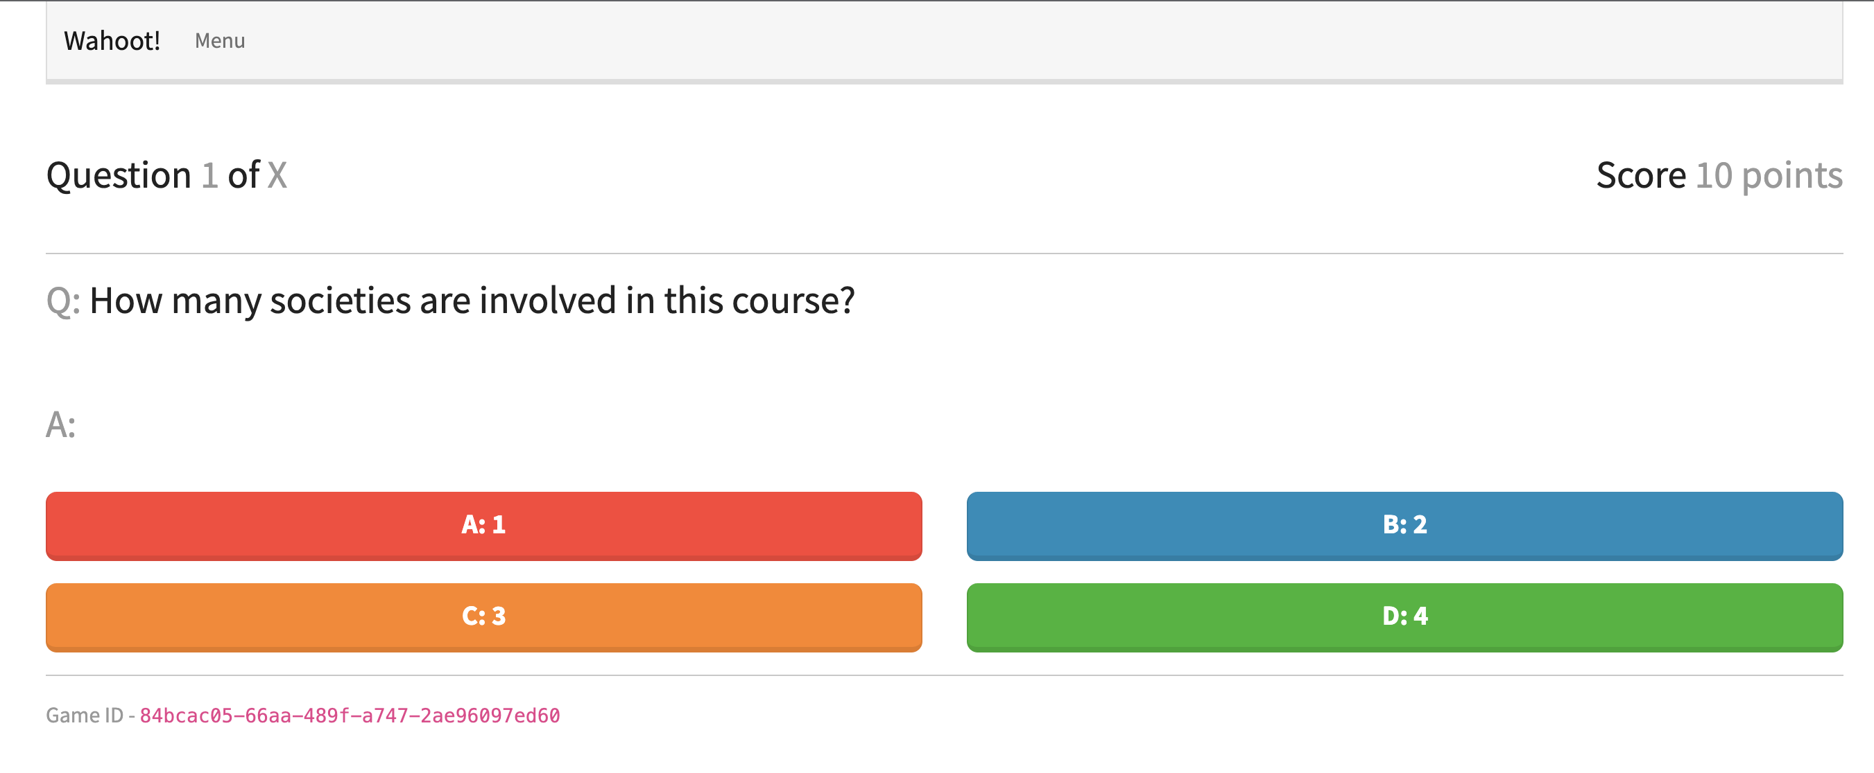
The Project:
A totally original and not blatantly ripped-off idea
Developed jointly by WAI and Computing
Completed by you, starting from Week 2!

Slide 13

“Everyone can code!”
- someone you know
That doesn’t mean it’s going to be easy.
You’ll have lots of functions!
Just don’t expect to learn everything within 12 hours.
Notes:
We’ve put a lot of effort into making this, but you also have to put effort into engaging with it
Ultimately, we hope you’ll have lots of fun! And find this useful for the future.
However, don’t expect to learn everything within 12 hours. After all - if I could snap my fingers and suddenly understand everything there is to know about programming, I wouldn’t need to bother doing my degree.

Slide 14
Week 1
Variables, Datatypes & Exceptions

Slide 15
By The End of Today...
Datatypes
Integers
Floats
Strings
Variables
Operations
You should be able to make basic Python scripts
Using basic functions
Type Casting
Exceptions & Basic Debugging

Slide 16
Programs Do Things To Data
In what order do these things happen?
What things can we do?
What can our program ultimately produce?
What types of data?
How can we reference it?
How do we represent this data in Python?
Notes:
But I think it’s better to view things like this. Ultimately, programs do things to data.
But what things can we do? In what order do these things happen? What can our program ultimately produce?
And on the other hand, what types of data? How do we represent this data in Python? And how can we reference it?

Slide 17
Variables

Slide 18

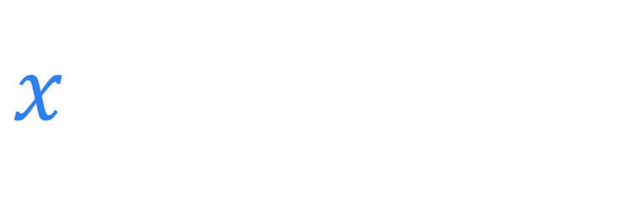
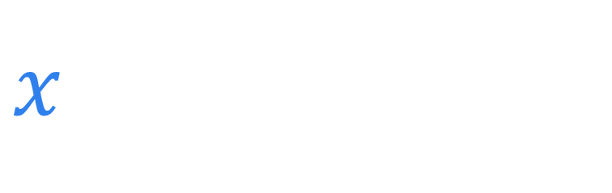
Variables
$$42+x=111$$
$x$ has a name
$x$ has a value
(nice)
Notes:
So, let’s start with variables. You’ve probably seen them before, in the context of maths – something like this.
The important part is that the variable here, x, has a name, and it has a value, in this case 69. (nice)

Slide 19
Variables
This means ‘is assigned’, not ‘equals’!
This is the integer
datatype (int)
hello = 38
hello has a name
hello has a value
Notes:
It’s similar in Python. If I write ‘hello = 38’, then I’m assigning the value 38 to the name hello. So hello has a name, hello has a value.
A couple things: the equals here means ‘is assigned’, not ‘is equal to’. Also, this data has a datatype – an integer, so a positive or negative whole number.

Slide 20
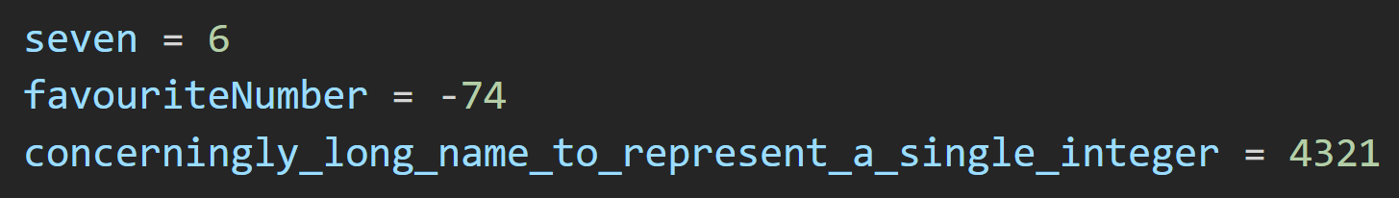
Variable Names
Cannot contain spaces
Cannot start with digits
Should represent spaces with underscores

Slide 21
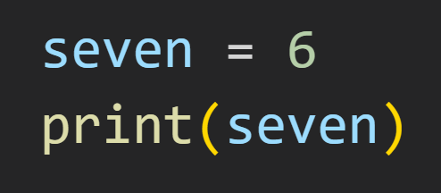
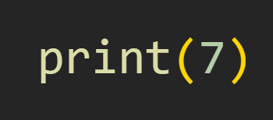
The Print Function
An argument – the data our function uses
Output: 7
Output: 6
Notes:
We can assign to some variables, but our program doesn’t output anything. This is because we haven't told Python to do that! To fix this, let's introduce the `print()` function. It's pretty simple - you put some data between the brackets, and it's going to be displayed.
Every function has to be referred to by a name, in this case 'print', and we call the value between the brackets an argument - the data the function uses. For now, think of functions as magical black boxes that either do something, or evaluate to something.

Slide 22

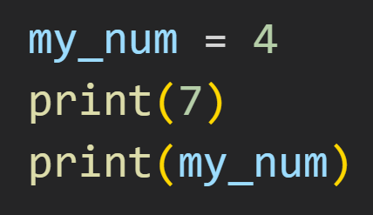

From Top to Bottom
7
4
Notes:
You can almost think of programming as a kind of cookbook.

Slide 23
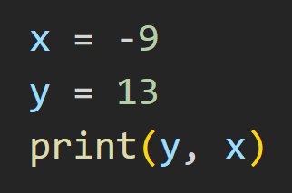
Multiple Arguments
The print() function also has a 2-argument version
We separate out multiple arguments with a comma
13 -9

Slide 24
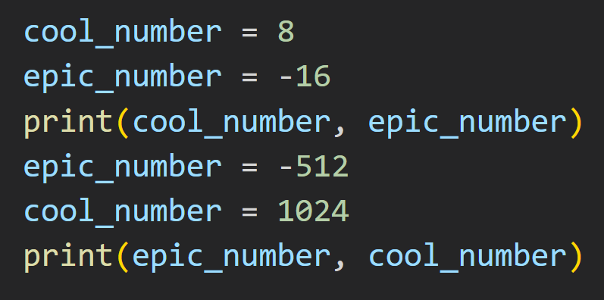
Rewriting Variables
8 -16
-512 1024

Slide 25
Operations

Slide 26
Operations on Integers
Operation | What It Does
+ | Adds two numbers
- | Subtracts two numbers
* | Multiplies two numbers
/ | Divides two numbers, always returns a float
// | Divides two numbers, returning the integer part
% | Divides two numbers, returning the remainder
Notes:
Most of them should be fairly recognisable, but it's worth noting the difference between `/` and `//`. Using the first one reveals another datatype: floating point numbers, or floats! Because not all numbers are created whole.

Slide 27
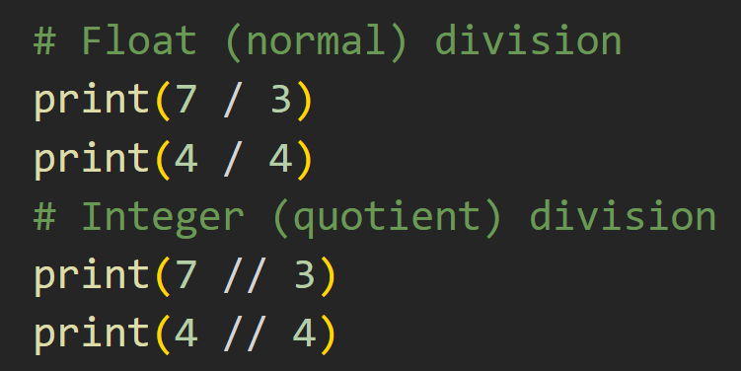
Floating Point Numbers (floats)
2.3333333333335
1.0
2
1
Some of you were probably wondering why this wasn’t a 4
Comments: anything after a # isn’t counted as code

Slide 28
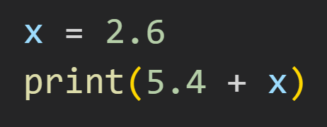
Floating Point Numbers (floats)
8.0
Notes:
You can also just write something as a float to begin with, like so.
Outputs 8.0 (float), not 8 (integer)!

Slide 29
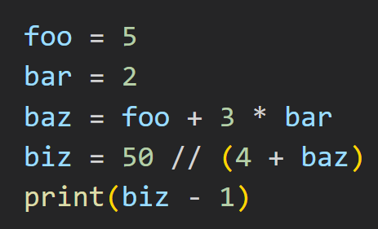
Operator Precedence Applies!
No brackets? The division would happen first.
BIDMAS
(then left to right)
2
Notes:
You can also just write something as a float to begin with, like so.
Outputs 8.0 (float), not 8 (integer)!

Slide 30
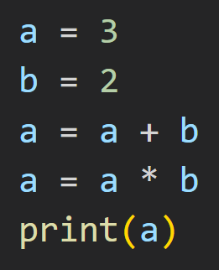
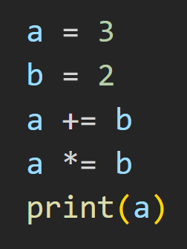
A little shorthand
10
10

Slide 31
Tasks 1-3 cover these concepts

Slide 32
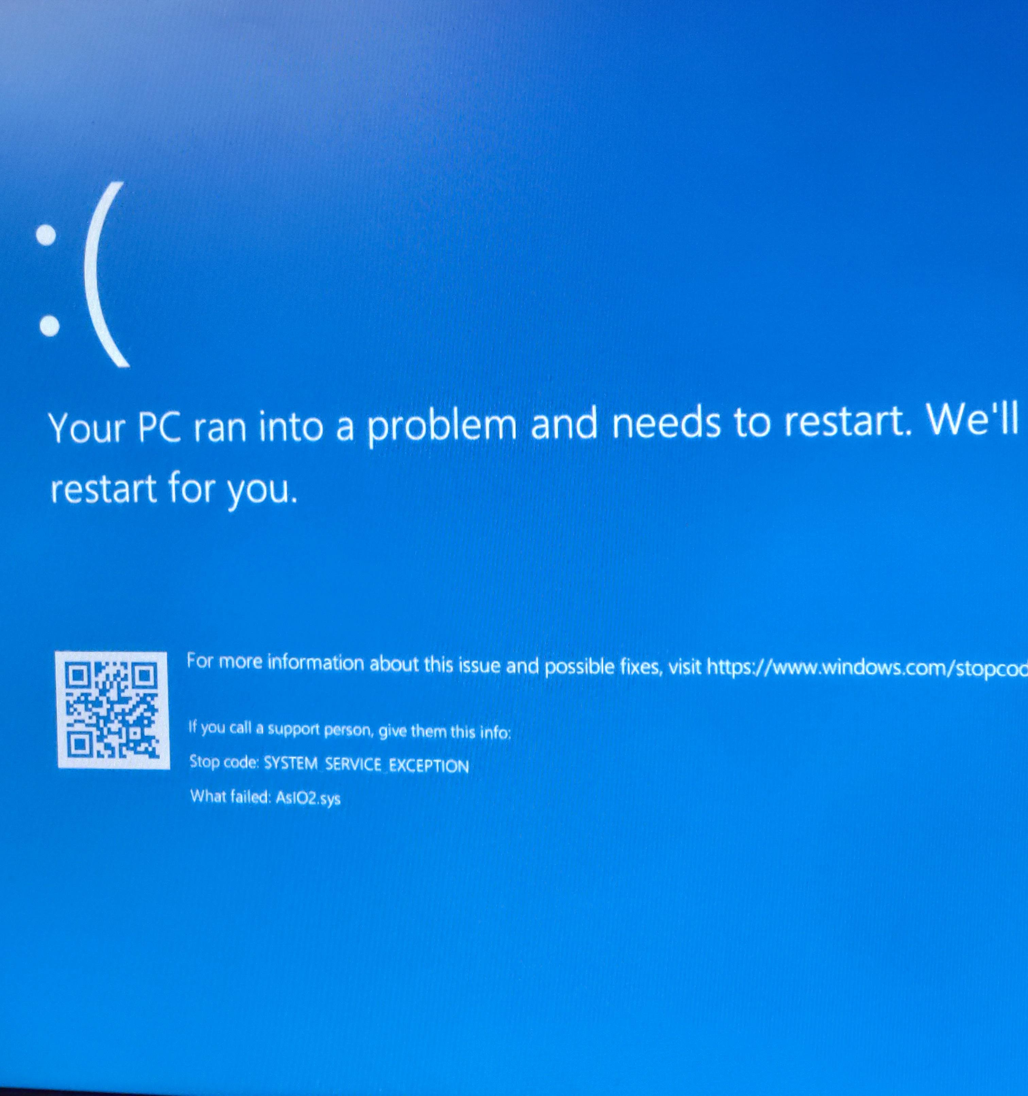
Exceptions
Notes:
Let’s talk about exceptions. You’ve probably already encountered them multiple times before. Here’s an example:
So, exceptions will pop up whenever something goes wrong with your program, and stop the rest of it from executing.
It won’t cause your entire PC to crash, don’t worry.

Slide 33
Problems with your code
Syntax - Your script doesn't follow the structural rules of the language.
Runtime - The structure is fine, but your script attempts to do something prohibited by the language while it's executing.
Logic - The script runs fine, but it doesn't do what you want it to.
Notes:
Now, problems with your code. It’s normal to run into these. Everyone makes mistakes when programming, even professionals. We can generally put these problems into 3 categories: Syntax, Runtime, and Logic.
Now, Python exceptions are only going to catch the first two, the last one is on you.

Slide 34
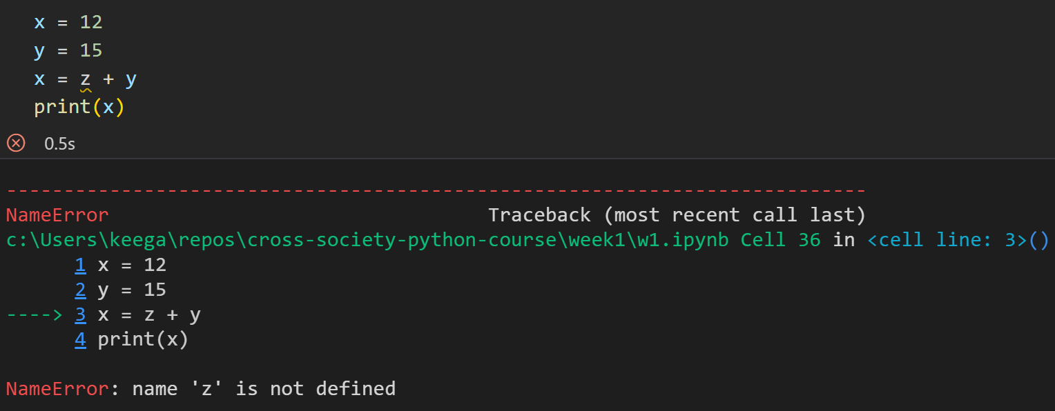
Understanding Exceptions
Notes:
Make sure to pay attention to the extra information exceptions give you, they usually give a pretty good indicator of the problem. If in doubt, you can always look up the error you're getting – for example, here it’s NameError.

Slide 35
Tasks 4 & 5 cover these concepts

Slide 36
Strings

Slide 37
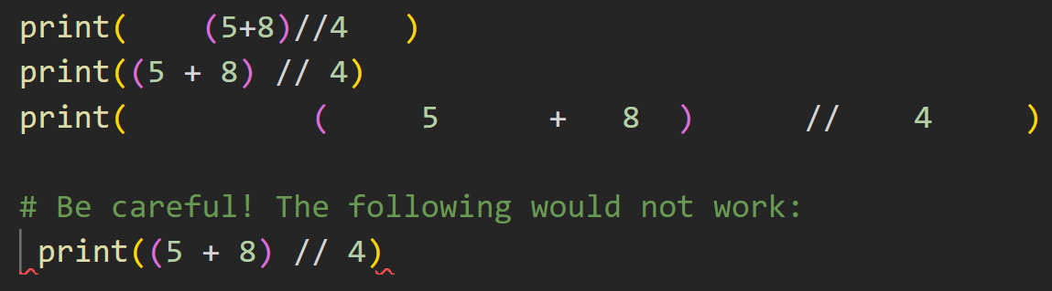
A note on s p a c i n g
Notes:
Before we discuss strings, a quick note on spacing. Python normally ignores any spacing after the start a line of code! So each of the three lines here are all equivalent. However, you can’t have any spacing before the first character. That’s called indentation, and we’ll discuss what it represents in Week 2.

Slide 38
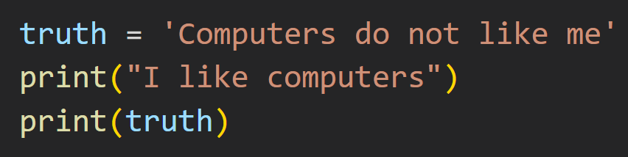
Strings are strung together
Surrounded in either single or double quotes.
I like computers
Computers do not like me
Notes:
Python represents text using something called a string - basically a collection of letters strung (get it?) together in some order. We'll revisit them in more detail when we discuss arrays, but for now just think of them as a big chunk of text.
What’s interesting is that spaces within strings are counted as the literal space character. Because of this, we need to define where they start and end, using either single or double quotes. And you can see that the spaces are printed too.

Slide 39
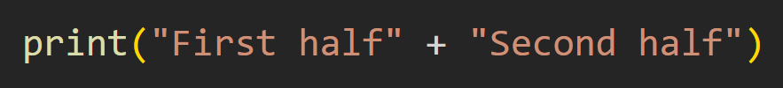
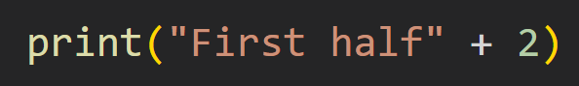
Operations on strings
First halfSecond half
TypeError: can only concatenate str (not "int") to str
Notes:
There’s a task that goes into more detail, but it’s worth knowing that when you add two strings, you combine them together (also known as concatenation).
But if you try to add a string and an integer, you get an exception, because the datatypes don’t match.

Slide 40
Tasks 6-9 cover these concepts

Slide 41
Type Casting

Slide 42
The Three Casts
str()
int()
float()

Slide 43
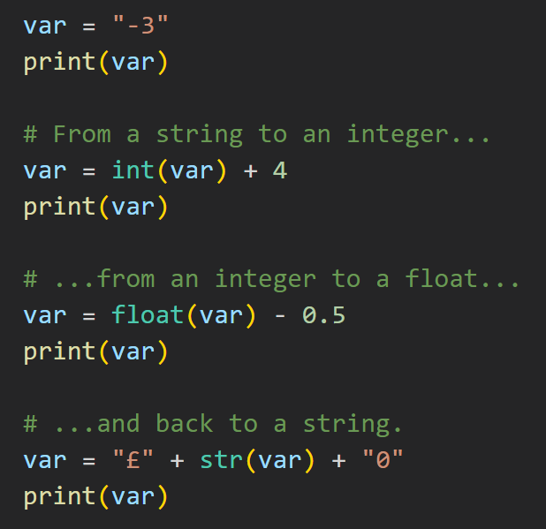
Cast Example
Casts are used to
convert to that type
-3
1
0.5
£0.50

Slide 44
Conversion Subtleties
String
Can Fail
Can Fail
Integer
Float

Slide 45
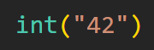
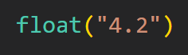
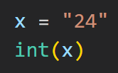
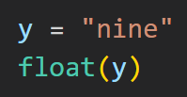
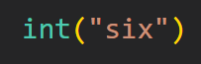
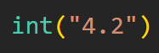
String to Float or Integer
🗸
🗸
🗸
✗
✗
✗

Slide 46
Conversion Subtleties
String
Can Fail
Can Fail
Can Widen
Integer
Float

Slide 47
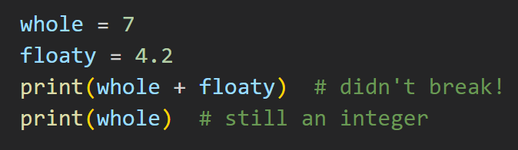
Can Widen
Integer
Float
11.2
7
Notes:
As floats are a type of number with more information than an integer - the cast happens automatically. We call this an **implicit cast**, because Python sees that the integer `whole` can have its type *widened* for that calculation. Neat!

Slide 48
Conversion Subtleties
String
Can Fail
Can Fail
Can Widen
Integer
Float
Loses Information

Slide 49
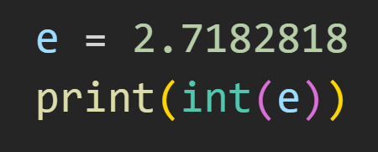
Integer
Float
Loses Information
2
Notes:
As floats store more information than an integer does, Python converts it by chopping off everything after the decimal point. This is called **type narrowing**, because we're losing information from the cast. So, this would output the engineer’s preferred version of e.

Slide 50
Conversion Subtleties
String
Can Fail
Can Fail
Can Widen
Integer
Float
Loses Information

Slide 51
Tasks 11-13 cover these concepts.

Slide 52
Input

Slide 53
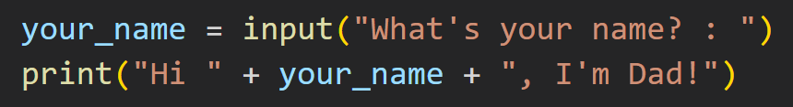
The Input Function
Bob
This function returns a string value.
Hi Bob, I’m Dad!

Slide 54
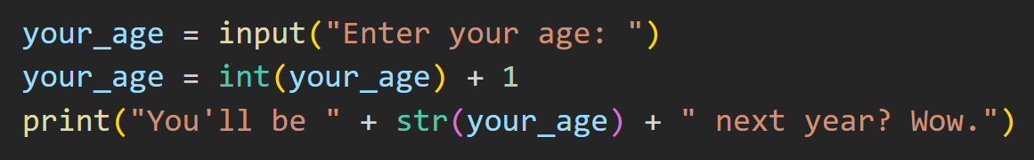
The Input Function
18
This function returns a string value.
You’ll be 19 next year? Wow.
Notes:
You can combine the input function along with casts to receive numbers as input.

Slide 55
Task 14 covers this concept.

Slide 56
Here’s What We’ve Covered

Slide 57
Programs Do Things To Data
In what order do these things happen?
What things can we do?
What can our program ultimately produce?
What types of data?
How can we reference it?
How do we represent this data in Python?
Notes:
But I think it’s better to view things like this. Ultimately, programs do things to data.
But what things can we do? In what order do these things happen? What can our program ultimately produce?
And on the other hand, what types of data? How do we represent this data in Python? And how can we reference it?

Slide 58
By The End of Today...
Datatypes
Integers
Floats
Strings
Variables
Operations
You should be able to make basic Python scripts
Using basic functions
Type Casting
Exceptions & Basic Debugging
Notes:
So, before we move on - Any questions?

Slide 59
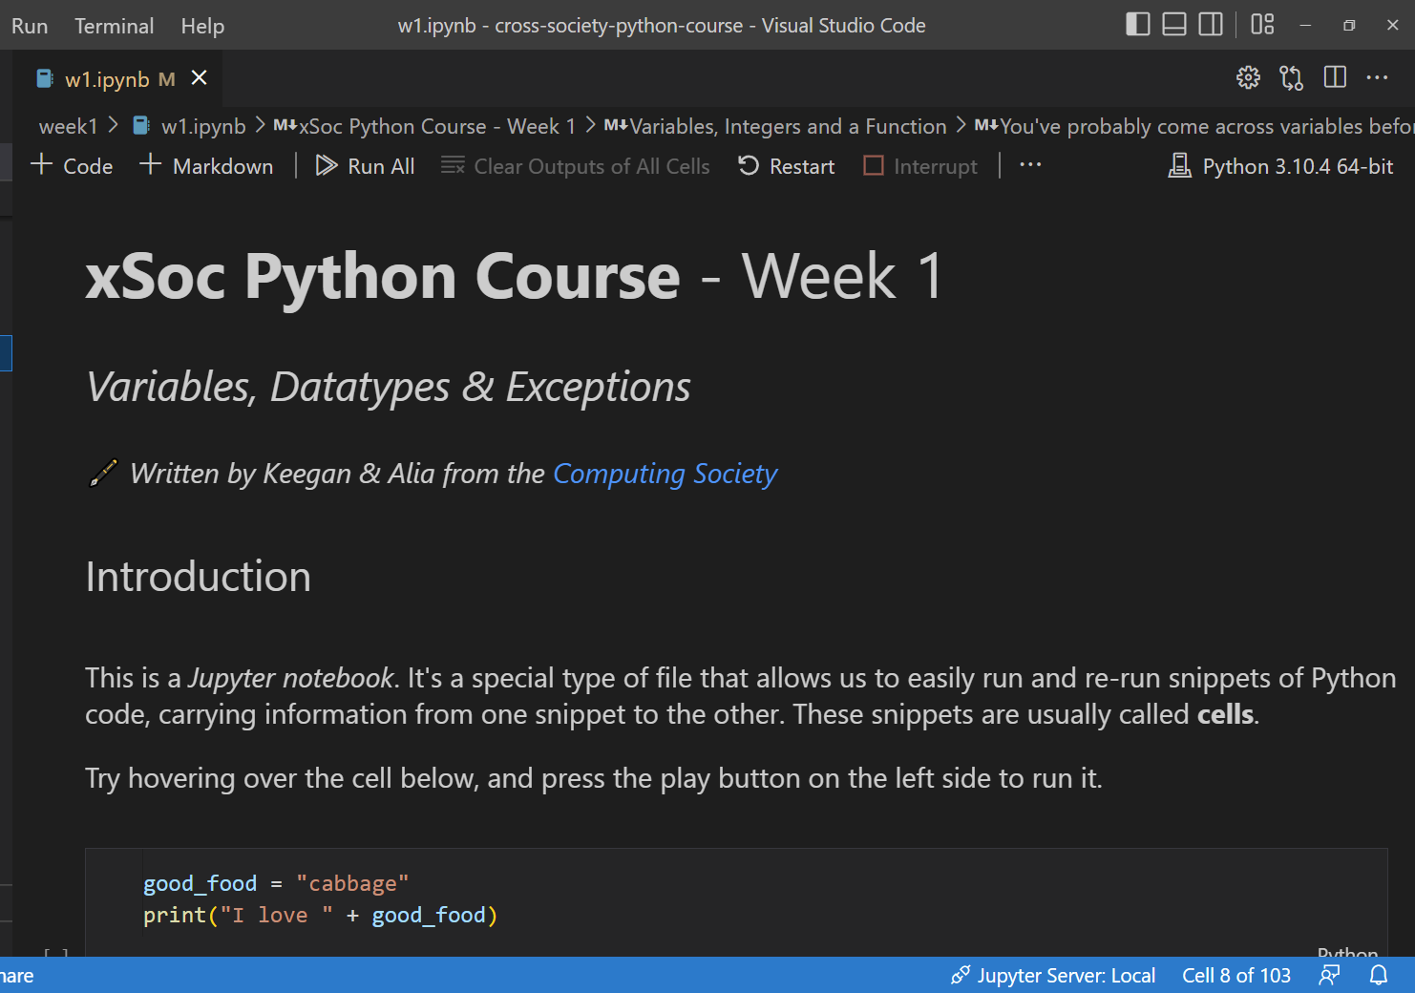
We’ve got a workshop for you!
It’s a Jupyter Notebook
(think Python with text blocks throughout)
You’ll open it with
Visual Studio Code
(very good programming tool)
There are 15 Tasks
(there are 5 more bonus tasks)

Slide 60
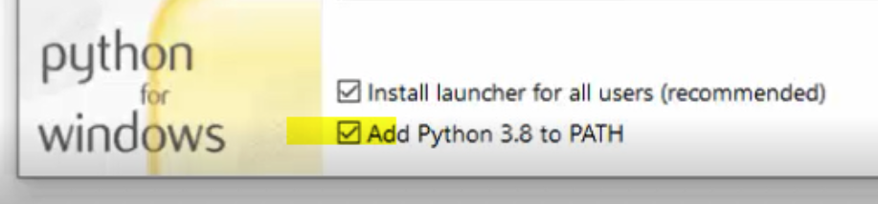
Step 1. Install Python
python.org/downloads
Install the latest version (3.10.7)

Slide 61
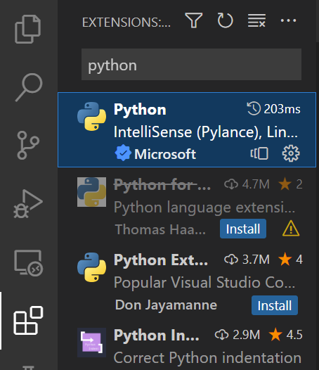
Step 2. Install Visual Studio Code
code.visualstudio.com
Install the latest version
Get the Python Extension Pack
(this also gets recommended when opening the notebook)

Slide 62
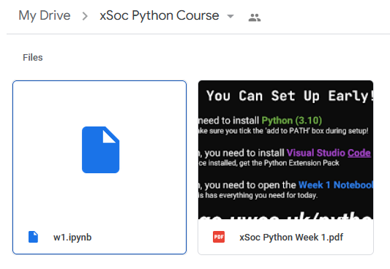
Step 3. Open The Notebook!
go.uwcs.uk/python

Slide 63

Questions for later?
Scan to join our Discord
Ask things in #python
We’ll do our best to answer

Slide 64
Week 1 Workshop

